Slide 1

Project Presentation
T20 world cup 2022
Prepared by
Navid zaman iD: 2020-2-60-044
MD Tahsin Id: 2020-2-60-112
Najnin Sultana Nishu ID: 2020-1-60-152
Sumaiya Sanjin Id : 2019-3-60-105
DM Rafiun Bin Masud Id : 2019-3-60-137
To
Md Al-Imran
Lecturer
Department of Computer Science & Engineering

Slide 2

Project Description
Our project is about Database of ‘ ICC Men's T20 World Cup’. There will be tables and other features. Here we can find match schedule of the tournament, venues. Moreover, it will show players details such as career with player images. Its not only about the players and venues information's. It will also show the team management, squad and tournaments records. Here, we can find a full of information's and queries.

Slide 3

objective
Here we have focused on the information's and other details about ICC T20 World Cup. It’s a computer or web-based application that manages all information whatever the user needs.

Slide 4
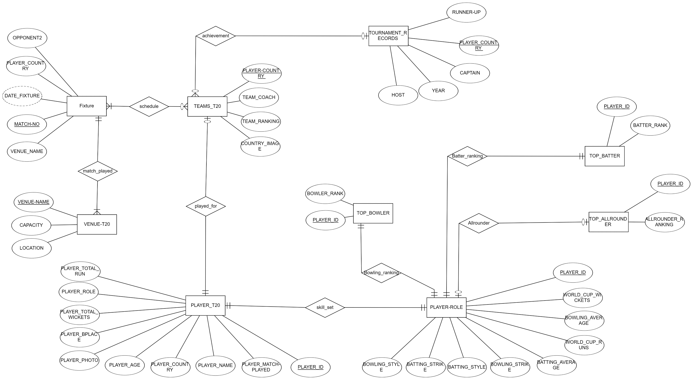
Er diagram

Slide 5
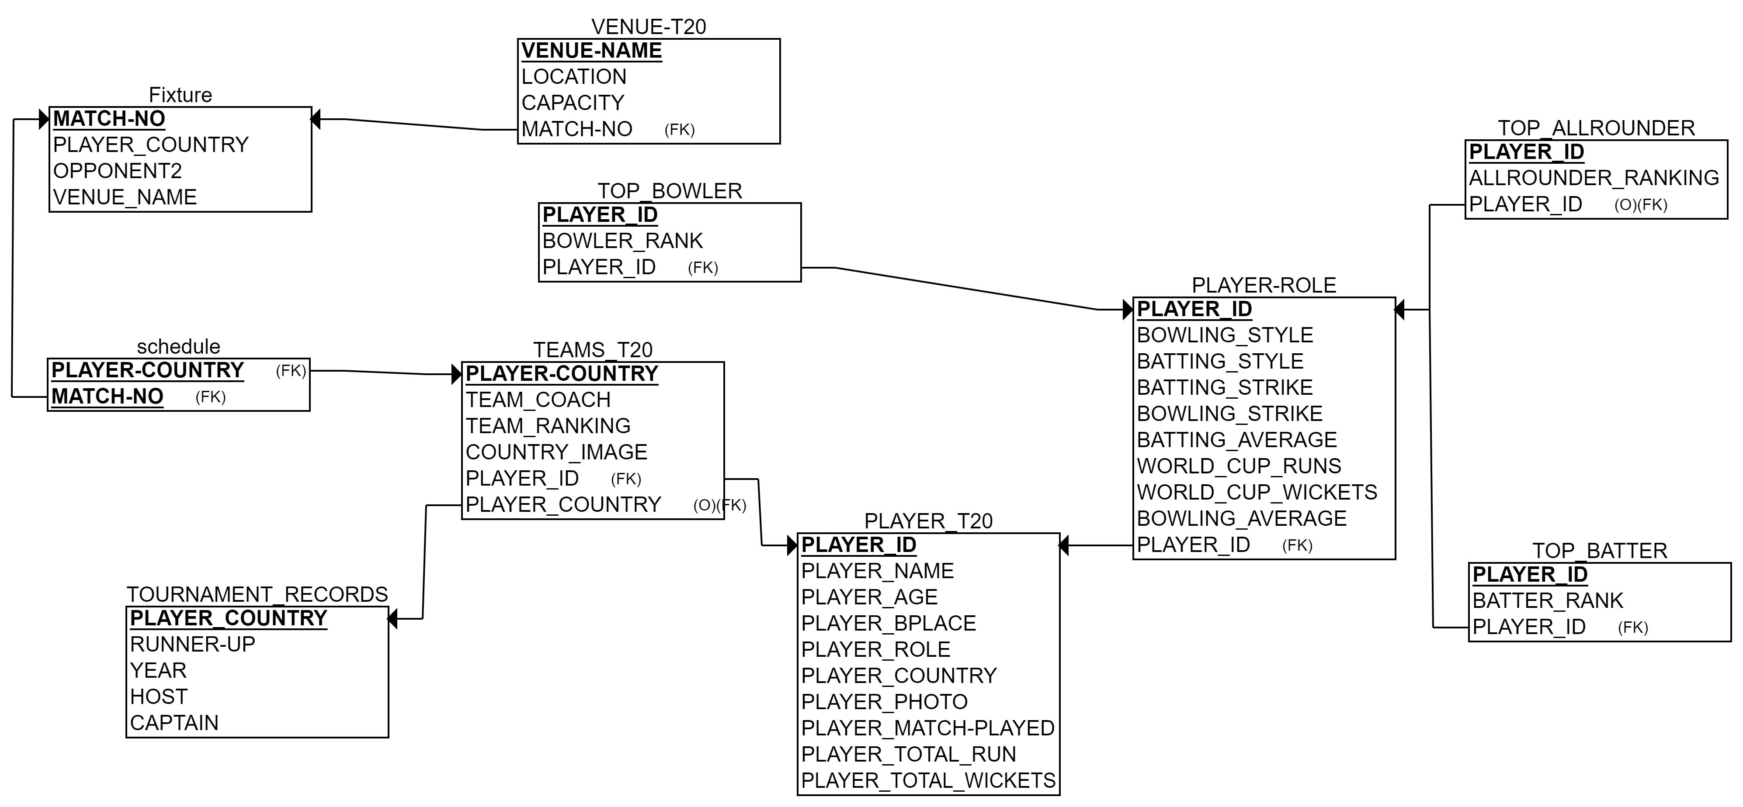
Relational schema

Slide 6
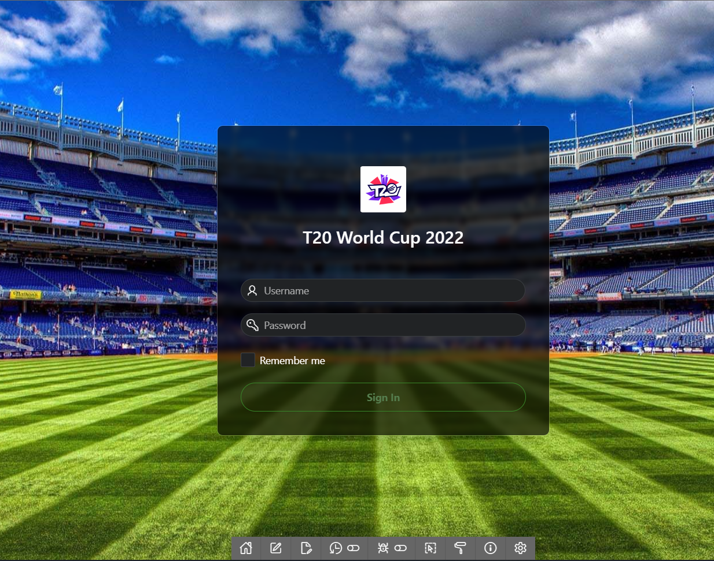
Login page
Were the user ID – admin_t20 and password- q1w2e3r4

Slide 7
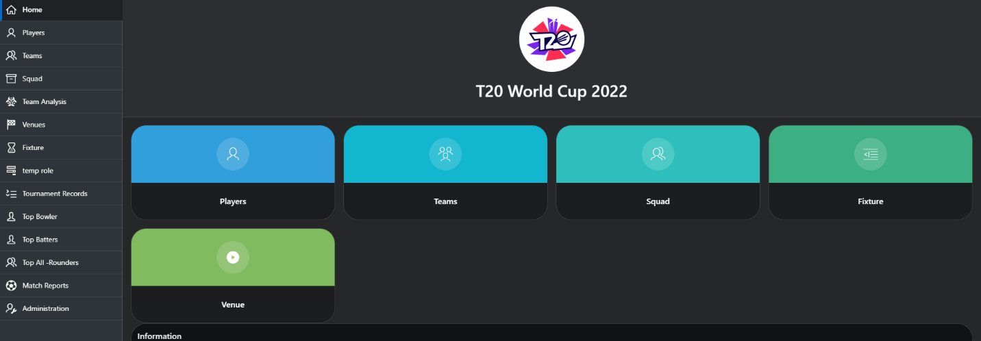
Home page
In this front page there are button. Which will help to go other pagers to get information of the tournament.

Slide 8
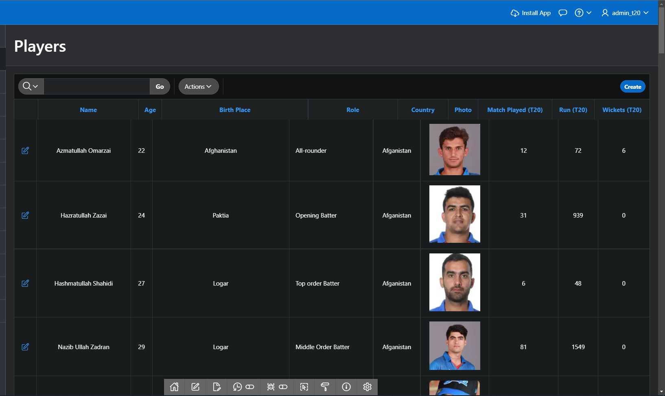
This table will show all the players information. It has search feature where user can search by player name. Below in the pictures we can see Rohit Sharma's information.
Player table

Slide 9
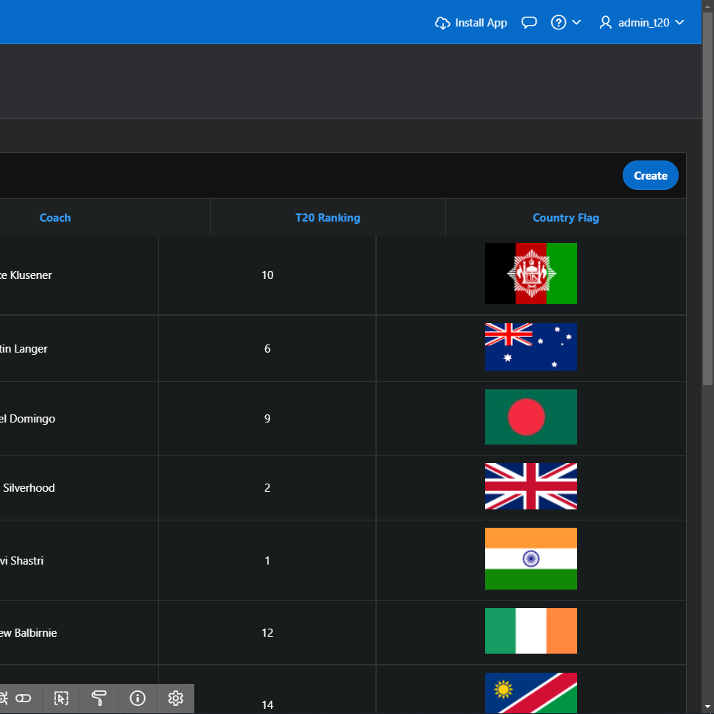
teams
In this table there are team. There are features that will help a user to know the exect information whatever they want.

Slide 10
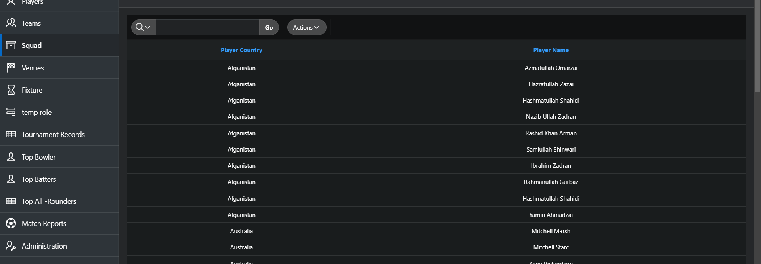
squad
This table will help a user to find squad list where all the list added order wise. There is a feature and that is searching.

Slide 11
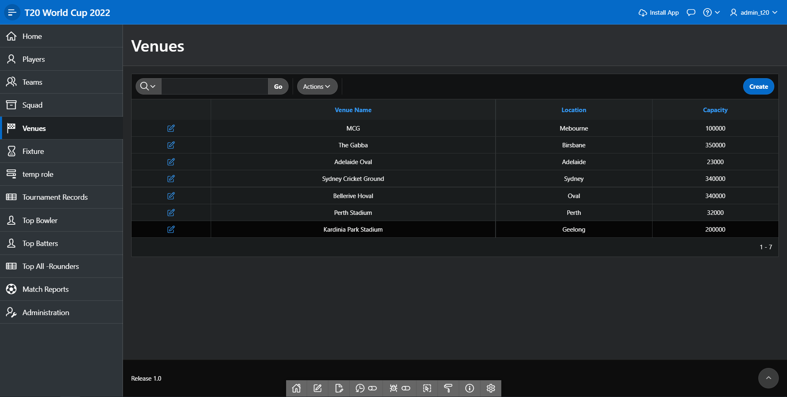
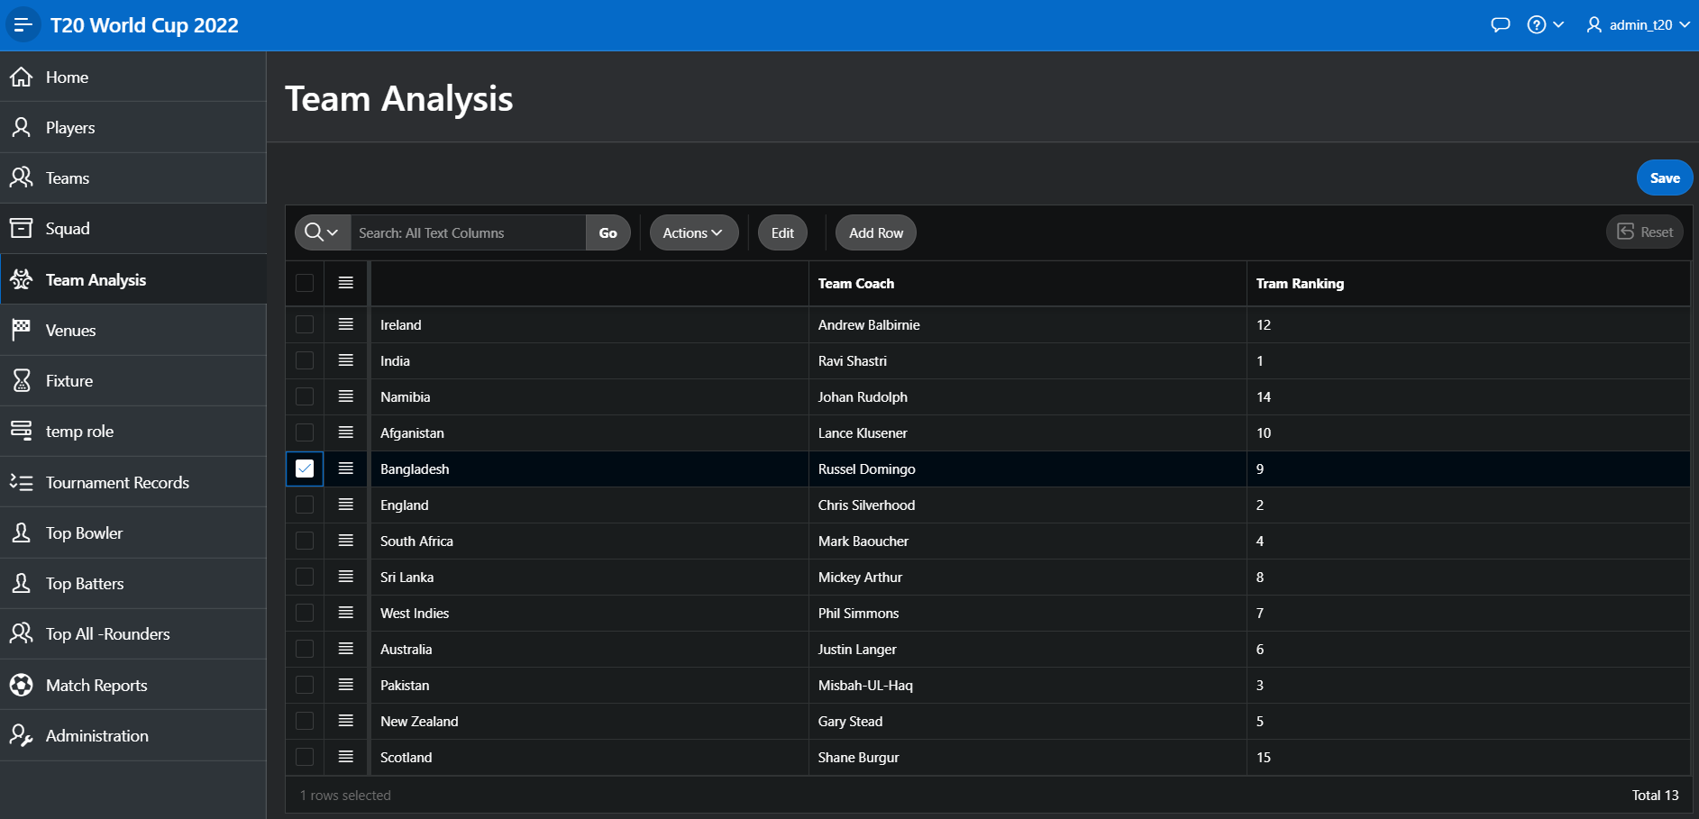
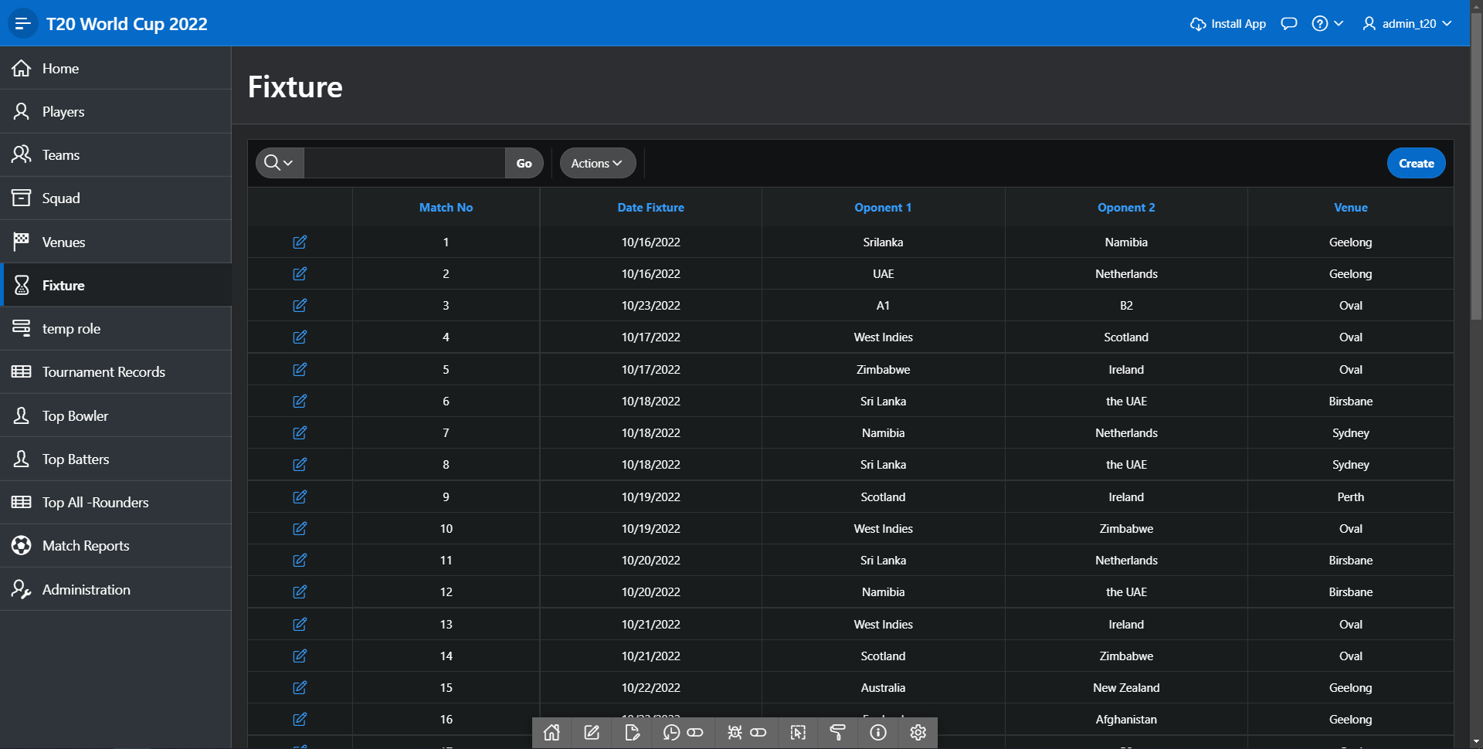
Venus team analysis fixture
Venus: In this venue table a user can see venue name with location and capacity.
Team Analysis: This is the Master Table where we can see two tables. Here, A list with county, ranking and team coach. The main feature is when user selects county it will show full team player information. We can see in the images below a user have selected Bangladesh and it show the list of the team.
Fixtures: All the match fixtures with date, place, team name have been defected.

Slide 12
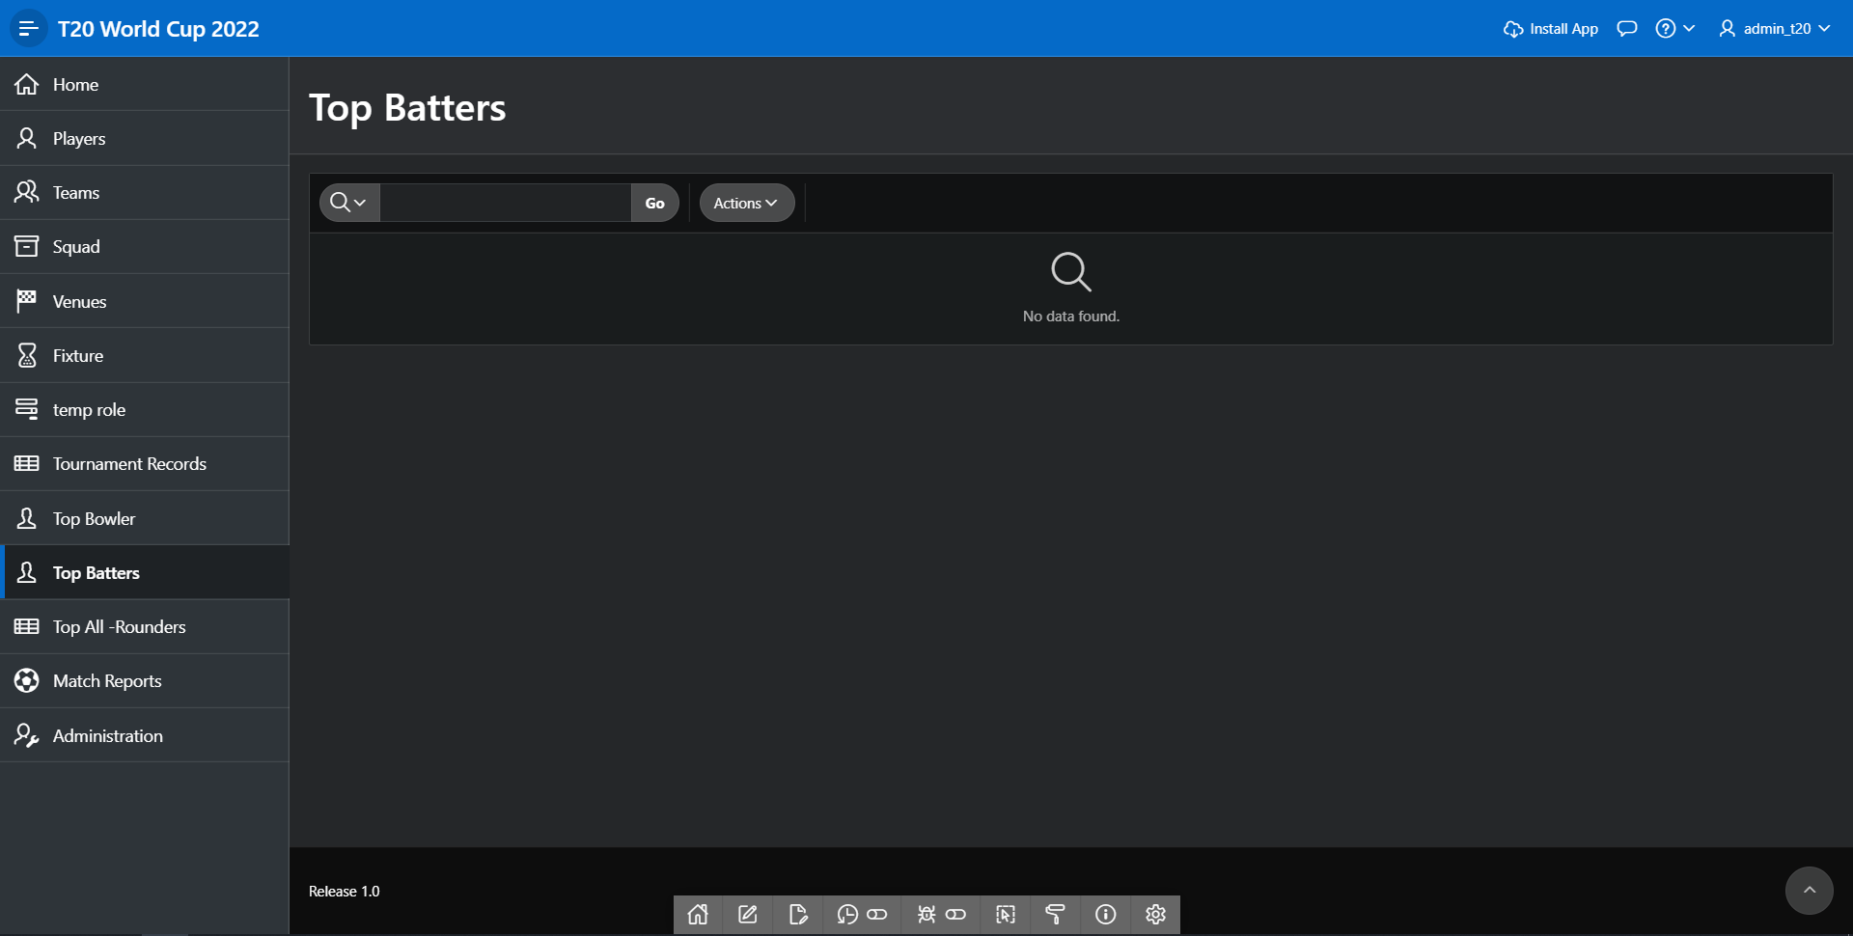
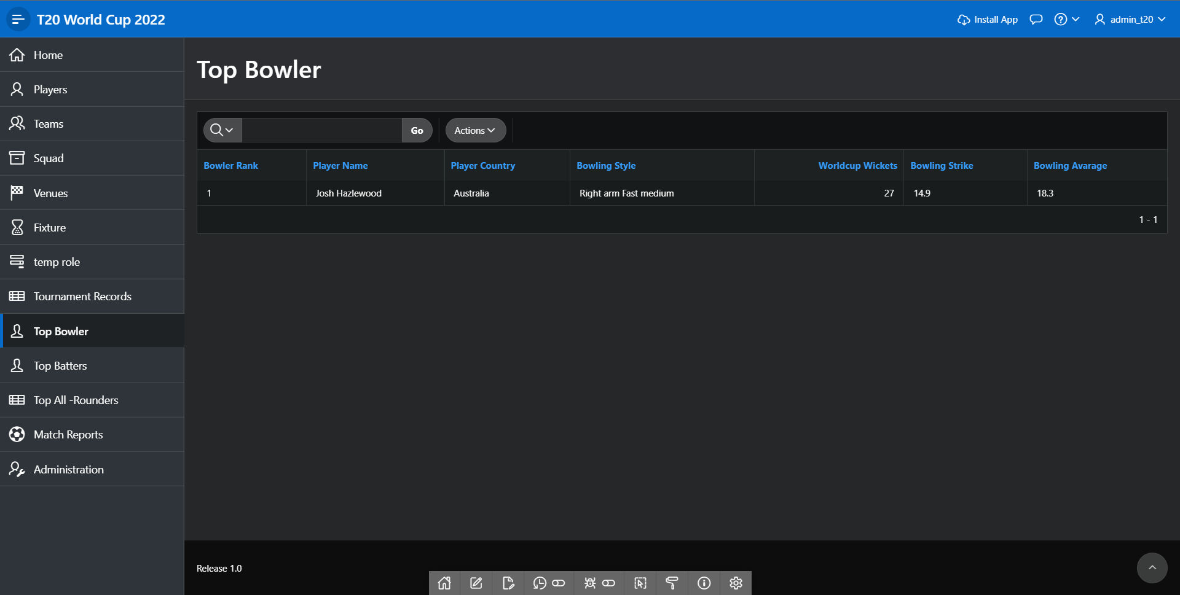
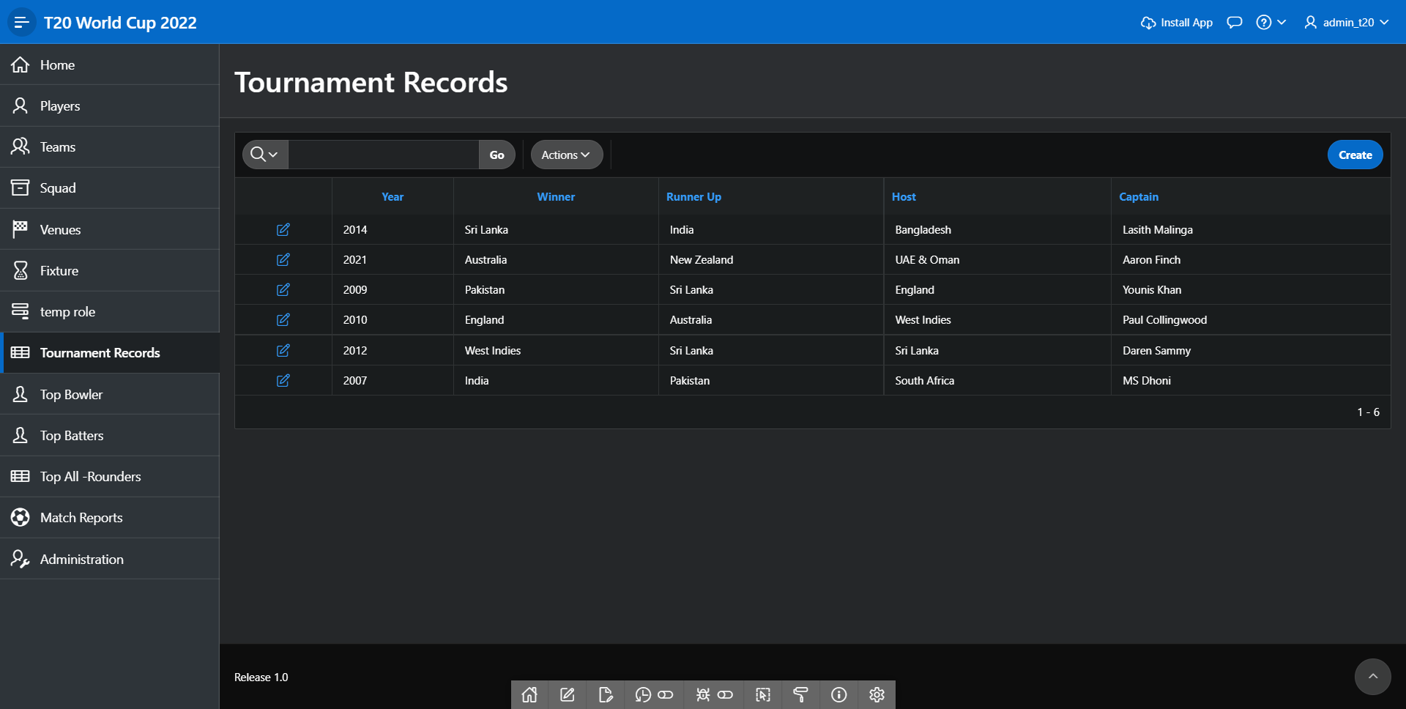
Top batters
Top bowler
tournament records
Top Bowlers: Here in this table, it will show top batters list. Where we can search by name of player.
Top Bowlers: Here in this table, it will show top bowlers list. Where we can search by name of player.
this table will show all the winners of past tournaments where we can see winners, runner up, host, captains name.

Slide 13
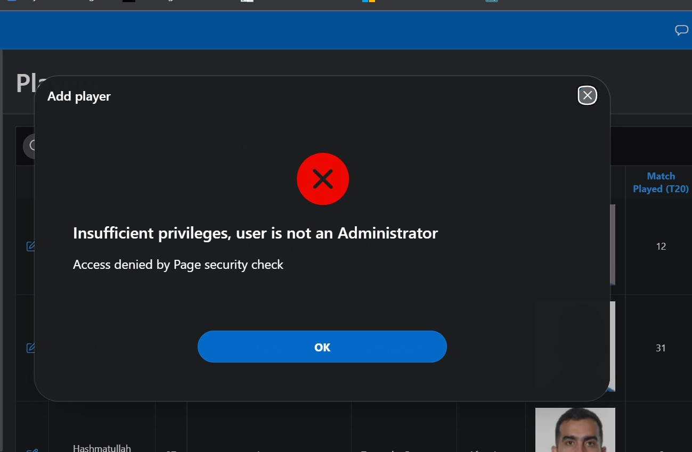
Custom authentication
Normal user cannot update the table because of authorization. For an example, we can see the image below an user tried to add player however it will deny the action.

Slide 14
conclusion
Here we use Oracle APEX to build an application “ICCT20 World cup 2022”. Here we learn how to build an application and add different type of page to make useful and learn how to authorize user and maintain database. Here we face some problem like image resize, use html and CSS, “space quota exceeded for tablespace” problem and this project consumes more time during data input. Because of this is a team project so, when we face any problem, we discuss and solve it quickly and there is the main fun to work with group project and there a team management issue is more important.

Slide 15
Thank you :)

